Slide 1
NAME : S Naveenaa INTERNSHIP : Data Analyst TASK 4

Slide 2
Design an interactive dashboard using Power BI. Analyze Sales, Profit, and Quantity.
Objective

Slide 3
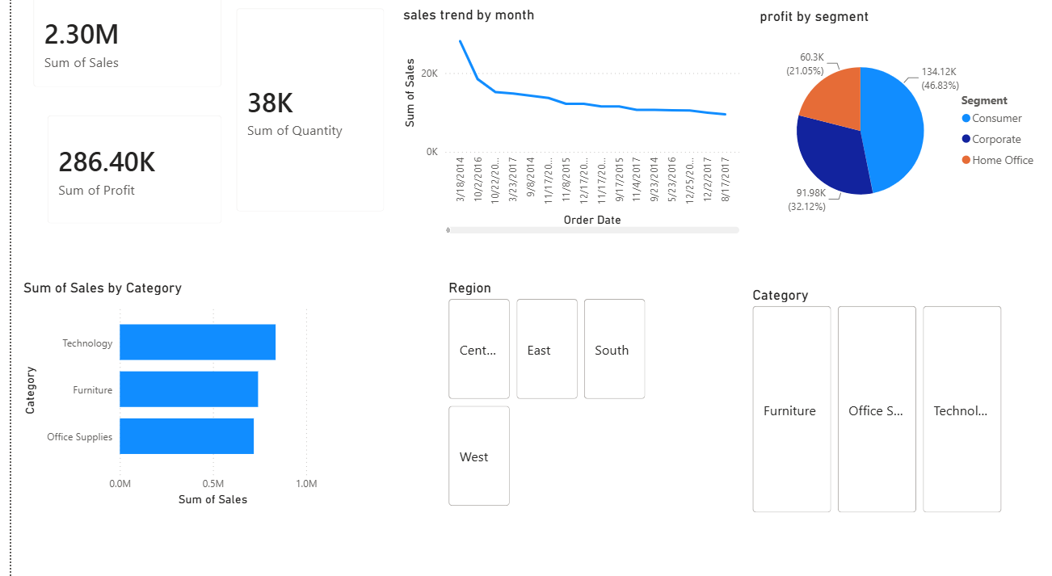
DASHBOARD
The dashboard includes:
• Total Sales
• Total Profit
• Total Quantity
• Sales by Category
• Sales Trend by Month
• Profit by Segment
• Region & Category slicers

Slide 4
conclusion
• Built an interactive Power BI dashboard.
• Visualized business performance.
• Dashboard supports business decision making.
Thank You

